Slide 1

Azure Functions Overview
Kyle McMaster
@KyleMcMaster
kyle.mcmaster@nimblepros.com | NimblePros.com
Notes:
To set footer:
Insert – Header and Footer – Footer – Apply to All (not title slide)

Slide 2

What are Azure Functions?
Event-driven, serverless compute platform
Supports functions, small pieces of code that do single things
Develop simple deployables for technology-specific microservices
Programmable in many languages like C#, Python, TypeScript and more!

Slide 3
Triggering Azure Functions
Timer triggers
HTTP triggers
Cosmos DB triggers
Events from Event Hub, Event Grid, or Azure Service Bus
SignalR and Notification Hub messages
Blob Storage triggers

Slide 4
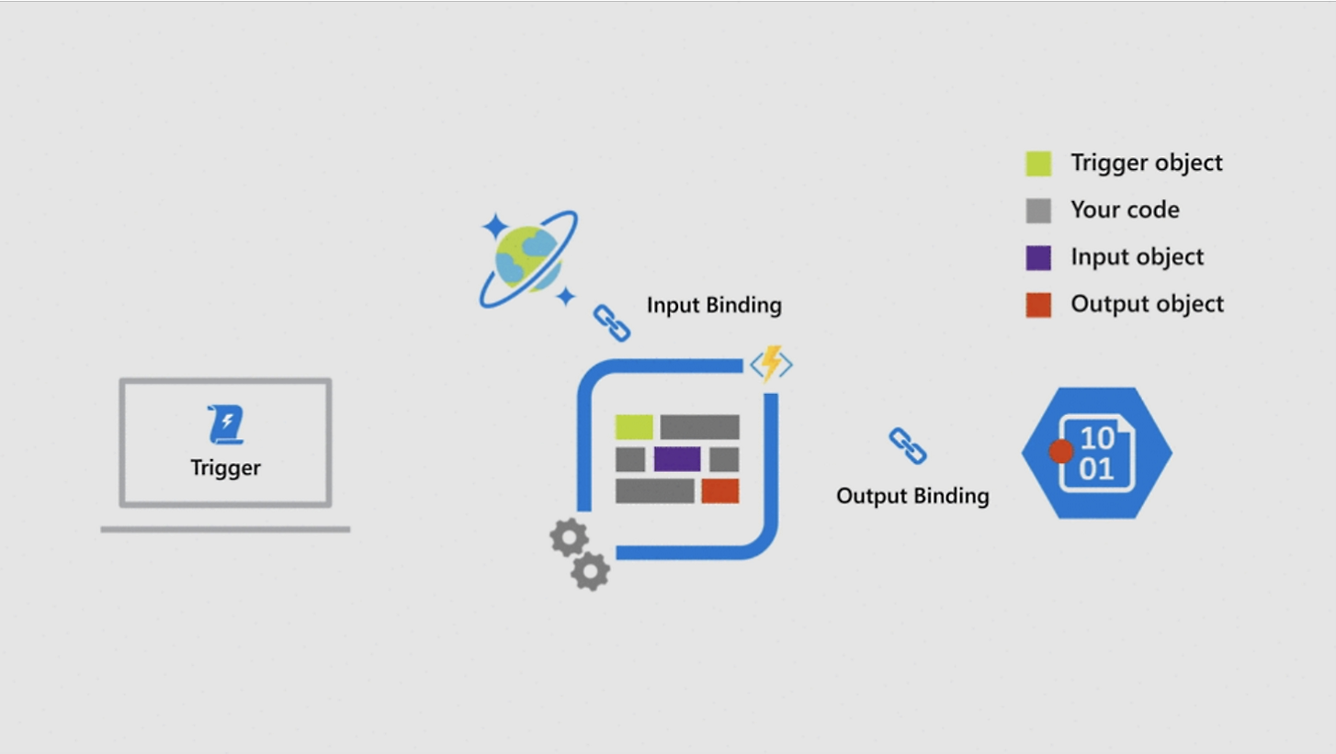
Azure Functions Bindings
https://cdn-dynmedia-1.microsoft.com/is/image/microsoftcorp/valprop4-1?resMode=sharp2&op_usm=1.5,0.65,15,0&wid=1454&hei=862&qlt=100&fmt=png-alpha&fit=constrain

Slide 5
Use Cases
Respond to HTTP requests
Process file uploads from Azure Blob Storage
Process messages from Azure Storage Queues
Run a process on a scheduled interval
Create serverless workflows With Durable Functions

Slide 6
Runtimes and Models
Azure Functions are built on top of the Azure Web Jobs SDK
Supported Runtimes
v1 (.NET Full Framework)
v4 (Current, .NET 6+)⭐
Models
In Process
Isolated Process

Slide 7
Hosting and Scaling
Consumption Plan
Scale out, configurable timeout options
Premium Plan
Avoid cold starts, longer timeouts, more resources, consistency
Dedicated Plan
Azure Container Apps (Preview) 💥

Slide 8
Resources
Bindings
https://learn.microsoft.com/en-us/azure/azure-functions/functions-triggers-bindings?tabs=isolated-process%2Cpython-v2&pivots=programming-language-csharp#supported-bindings
Samples
https://learn.microsoft.com/en-us/azure/azure-functions/functions-dotnet-class-library?tabs=v4%2Ccmd
Use cases
https://learn.microsoft.com/en-us/azure/azure-functions/functions-scenarios?pivots=programming-language-csharp
Hosting plans
https://learn.microsoft.com/en-us/azure/azure-functions/functions-scale#overview-of-plans

Slide 9
Durable Orchestrations
Now we are going to talk about this…

Slide 10
Durable Orchestrations
Asynchronous workflow orchestration for Azure Functions
Enables stateful Functions in serverless compute environment
Built on Durable Task Framework
Error Handling, Retries, Fan In/out concepts baked in

Slide 11
Samples
Backup site content
https://learn.microsoft.com/en-us/azure/azure-functions/durable/durable-functions-cloud-backup?WT.mc_id=dotnet-sample-marouill&tabs=csharp#e2_backupsitecontent-orchestrator-function
Waiting for external user input
https://learn.microsoft.com/en-us/azure/azure-functions/durable/durable-functions-phone-verification?tabs=csharp

Slide 12
Considerations
Orchestrations can be replayed
Orchestrators should be idempotent
Activities can contain async or state dependent mutations
State is serialized and persisted to Azure Storage Queues/Tables
Implications of long running “stateful” processes
https://learn.microsoft.com/en-us/azure/azure-functions/functions-overview?pivots=programming-language-csharp

Slide 13
Summary
Azure Functions are awesome!
Simple and manageable microservices when used correctly
Durable orchestrations allow for complex workflows and processes

Slide 14
Extra Fun
Kubernetes! https://github.com/Azure/azure-functions-core-tools?tab=readme-ov-file#getting-started-on-kubernetes
Functional Testing
https://github.com/KyleMcMaster/azure-function-functional-tests https://learn.microsoft.com/en-us/azure/azure-functions/durable/durable-functions-diagnostics?tabs=csharp-inproc

